Slide 1
Utility Usage Prediction Tool
CODEVEDX AI/ML Internship
Developed By: Sanchit Doshi

Slide 2
Project Overview
• Predicts electricity usage
• Console-based
• CSV storage
• Linear Regression

Slide 3
Technologies & Dataset
Python
Pandas
Scikit-learn
Dataset: Project1.csv
Columns: Day, Electricity_Usage

Slide 4
Features
• Add Data
• Update Data
• Delete Data
• View Data
• Predict Usage
• Exception Handling

Slide 5
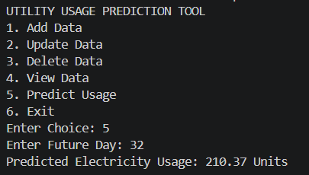
Output
Sample:
Enter Future Day: 32
Predicted Electricity Usage: 210.37 Units

Slide 6
Conclusion
Project successfully predicts electricity usage using Machine Learning.
Thank You!!!

